Slide 1
Analyzing Video Game Sales
By Amandeep Rathee
11/26/2019

Slide 2
Introduction
Data about number of video games sold from 1985-2016. Source: Metacritic and Kaggle
Variable Name | Description
Name | Name of the game.
Platform | PlayStation, Xbox, Nintendo, etc.
Year Of Release | Integer from 1985 to 2016.
Genre | Sports, Arcade, Action, etc.
Publisher | EA, Activision, Ubisoft, etc.
Critic Score | Average rating given to the game by Metacritic staff.
Critic Count | Number of staff members who rated the game.
User Score | Average rating given by users.
User Count | Number of users who rated the game.
Developer | Company that developed the game.
Rating | Who is the game appropriate for – “teens”, “adults”, “children”, etc
Global Sales | Number of units sold as of December 2016.
16000 observations but only 7000 complete cases. Got rid of rows with missing value(s).

Slide 3
Questions
Which platform is the most successful in terms of video game sales?
Who determines the success of a game – users or critics?
Which genres (sports, racing, action, etc.) have positive impact on sales?

Slide 4
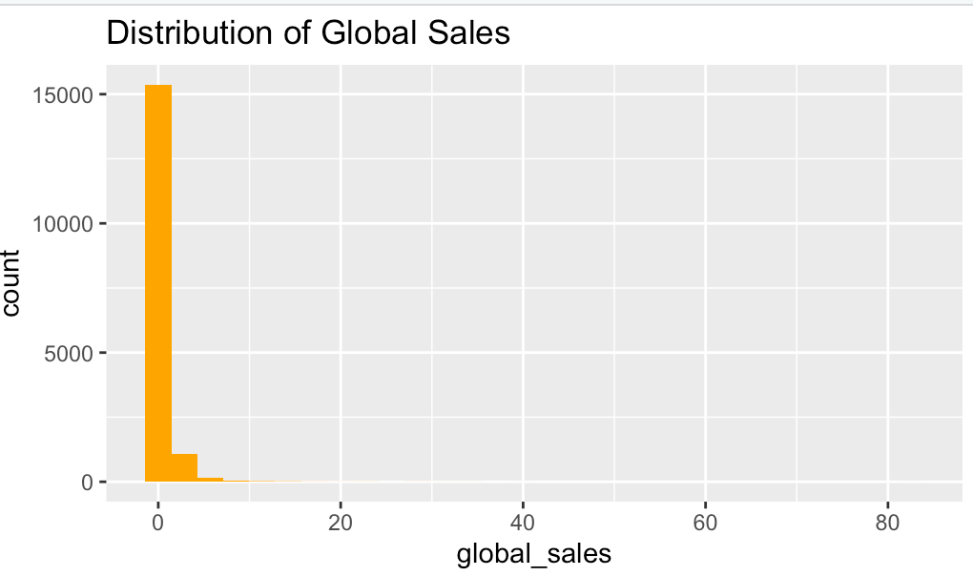
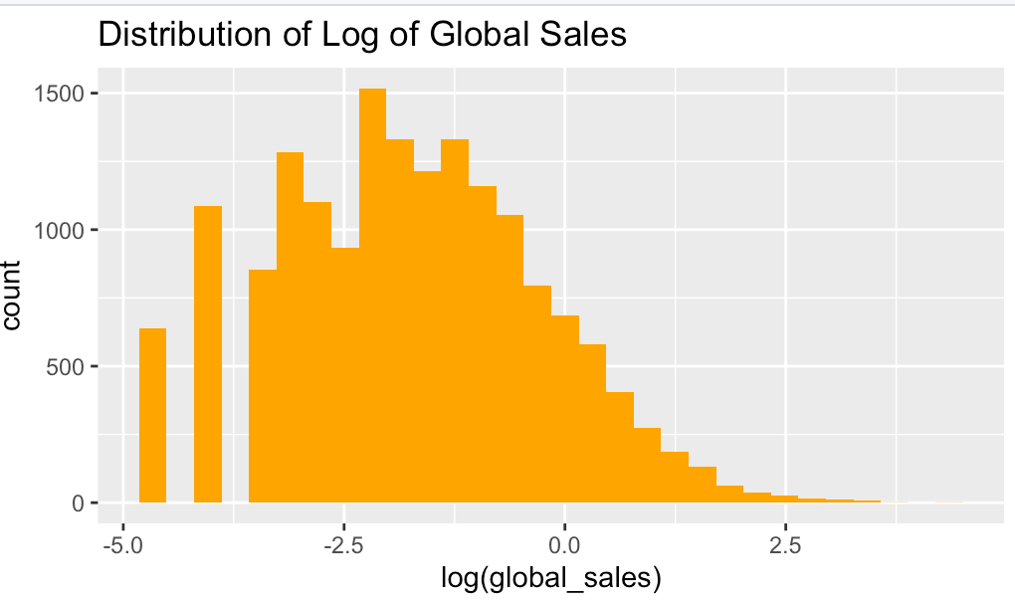
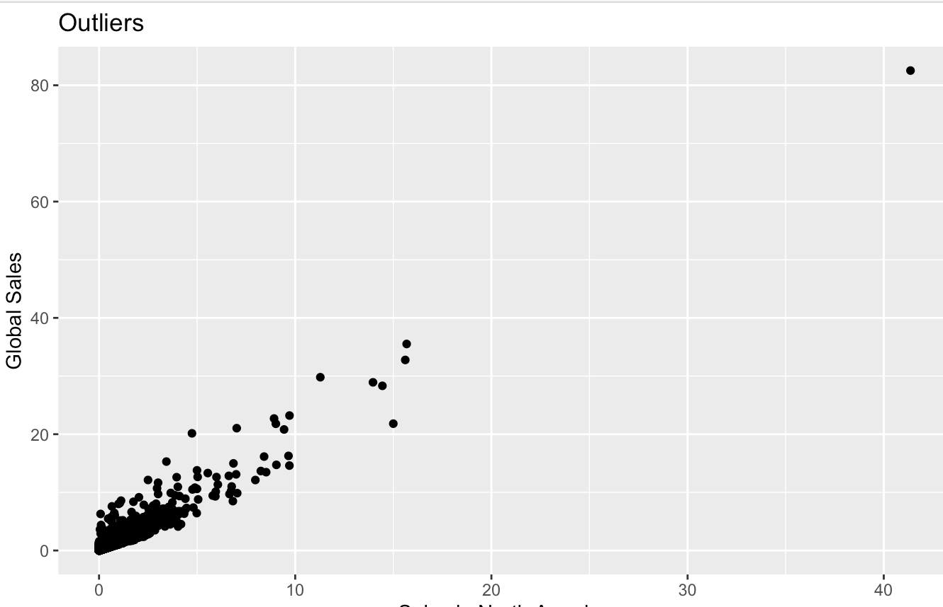
Exploratory Data Analysis
Response variable, global sales, is highly skewed.
Lots of extreme values (outliers).
Developer and Publisher have more than 1000 levels – will ignore them.
Rating has 8 levels but 4 of them have 99.92% data – “everyone”, “10+”, “13+” and “18+”.

Slide 5
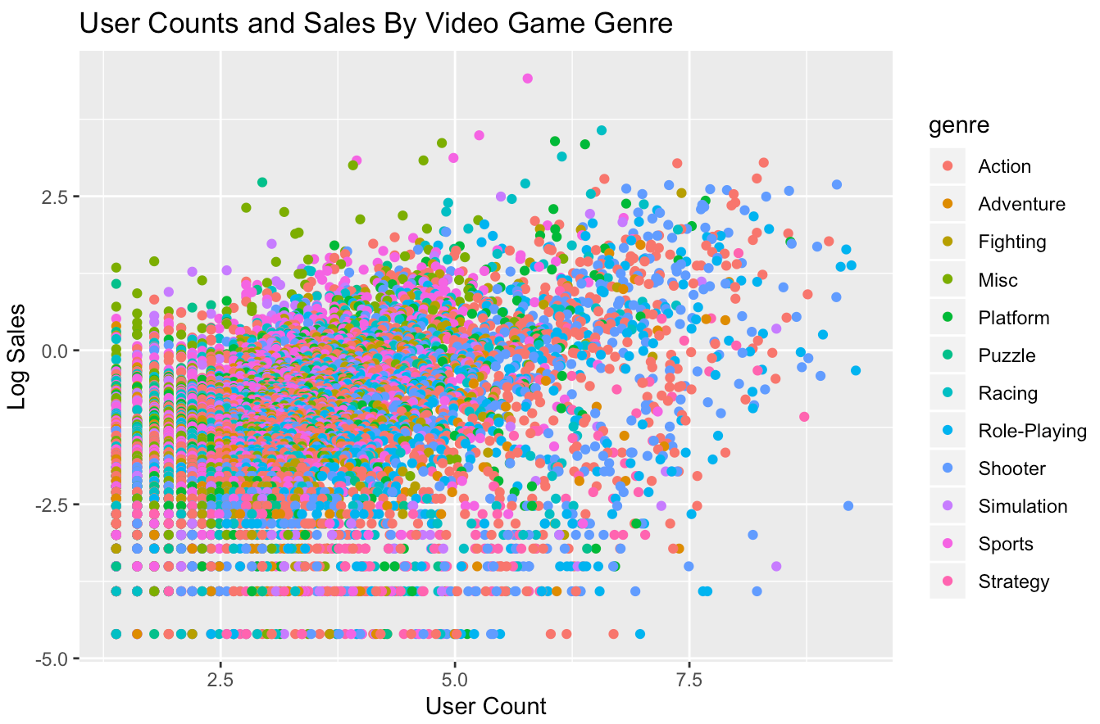
EDA
There seems to be an interaction between user count and genre.
Tried other such interactions in modeling.

Slide 6
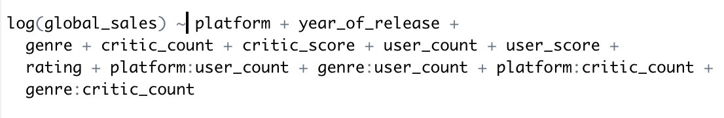
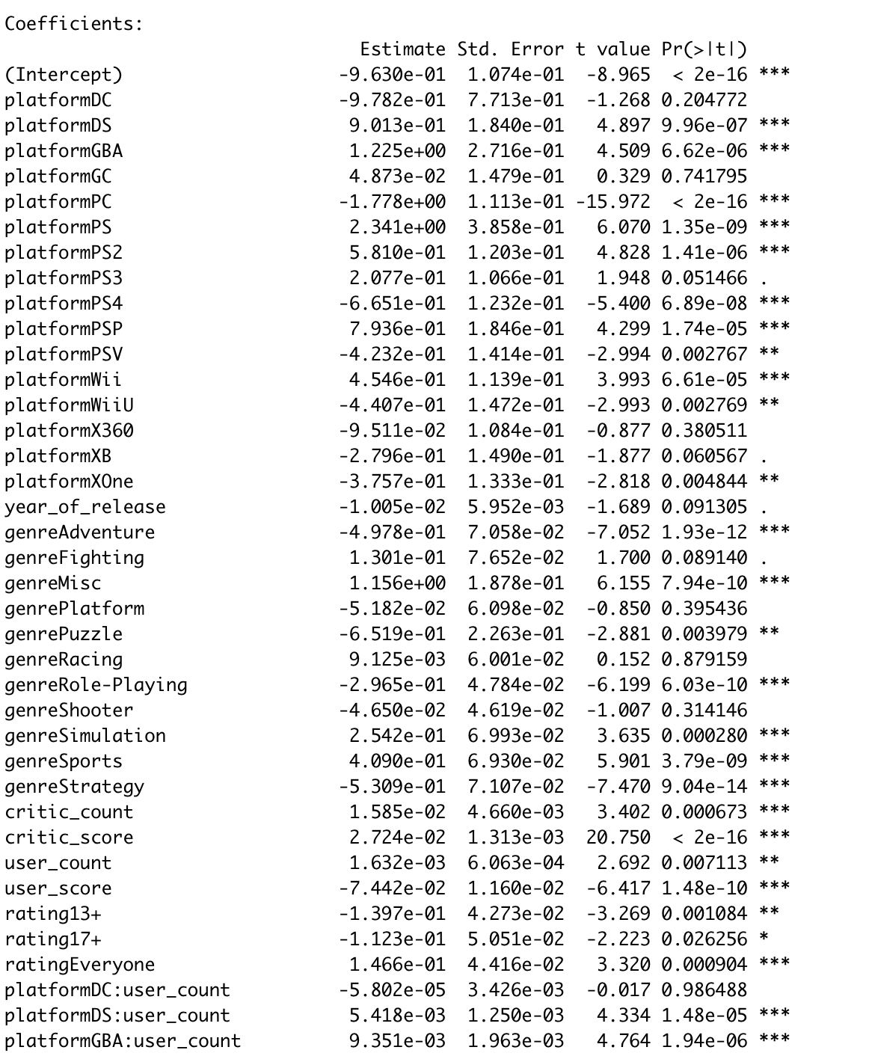
Modeling
Model Equation:
Raw Coefficients:
Old consoles have positive impact on sales.
New ones have negative impact
Critic count, critic score and user count have positive impact on sales
But user score has negative impact.

Slide 7
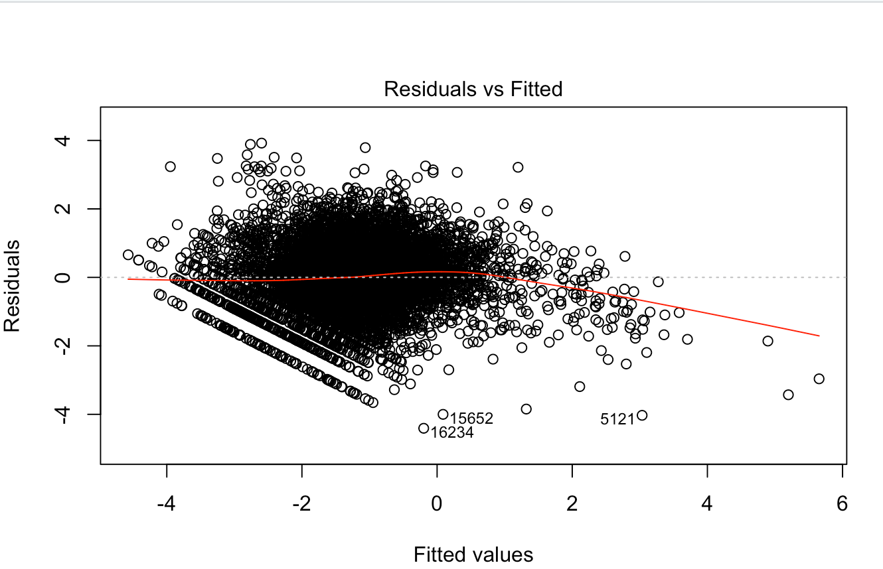
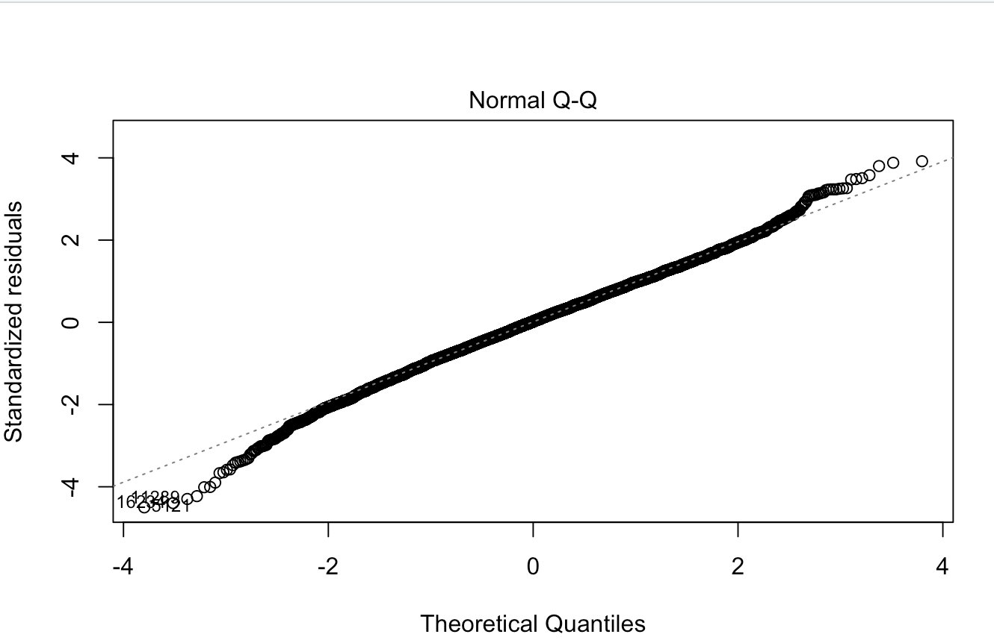
Model Validation
Something is wrong with the residuals. Highly skewed response might be the reason.
The QQ plot looks good though.

Slide 8
Conclusion
Problems:
Skewness: Response variable sales is highly skewed. Most sales are closer to zero.
Outliers: Some values in the response variable are extreme.
Residuals are not independent.
New consoles have negative coefficient which doesn’t make sense.
Things to try:
Aggregate gaming consoles: Reduce the number of consoles (plaforms) by by combining similar platforms. For example, instead of having Xbox, Xbox One, Xbox 360, create one category “XBOX”.
Model with and without outliers to see whether outliers should be removed.

Slide 9
Thanks!

